Slide 1
Monday, August 20, 2012
TISK Problems
Simplify: $\frac{21}{\sqrt{7}}$
Simplify: $2\sqrt{45}+7\sqrt{21}−4\sqrt{63}$
Divide: $\frac{4}{21}÷\frac{8}{7}$
We will have 3 Mental Math questions today.

Slide 2
Return of Graded Work
Reminder: Chapter 1 Test is this Thursday
Quiz Corrections should be turned in when finished or at tutoring.
Tutoring after school today will be in room 219.

Slide 3
§2-1 Inductive Reasoning & Conjecturing
Inductive Reasoning
Using several smaller examples to arrive at a larger, more general conclusion.
Conjectures
Educated guess based on observed details
Examples:
I have been to Seattle 3 times in my life. Every time I went it was raining. I conjecture that it is always raining in Seattle.
I notice that when open the angle the door makes with the door frame is complementary to the angle the door makes with the wall. I conjecture that the measures of these angles add up to 90 degrees.

Slide 4
More Inductive Reasoning Examples
I notice that the everyone in this class is wearing black socks. Everyone is also in 9th grade. Therefore, I conjecture that all 9th graders wear black socks.

Slide 5
Conjecturing
Make a conjecture and draw a figure to illustrate your conjecture.
Given: Points A, B, C, and D, AB = 5, BC= 10, CD = 8 and AD = 12.
5
10
8
A
B
C
D
12?

Slide 6
Conjecturing
Make a conjecture and draw a figure to illustrate your conjecture.
Given: Points A, B, C, and D, AB = 5, BC= 10, CD = 8 and AD = 12.
5
Conjecture:
ABCD is a quadrilateral.
A
B
10
12
8
C
D

Slide 7
A Good Read
Interested in learning more about inductive reasoning?
Check out: http://www.spcollege.edu/spg/math/rutledge/CH02SEC01_3e.pdf
This link will be provided on the Homework Calendar.

Slide 8
Counterexamples
Once a conjecture has been made, it is up to the mathematician to prove it is either right or wrong all the time.
In order to prove some conjecture is wrong, you need only provide a single counterexample.
A counterexample is an example that meets all the requirements of the given information but does not match the conjecture being tested.

Slide 9
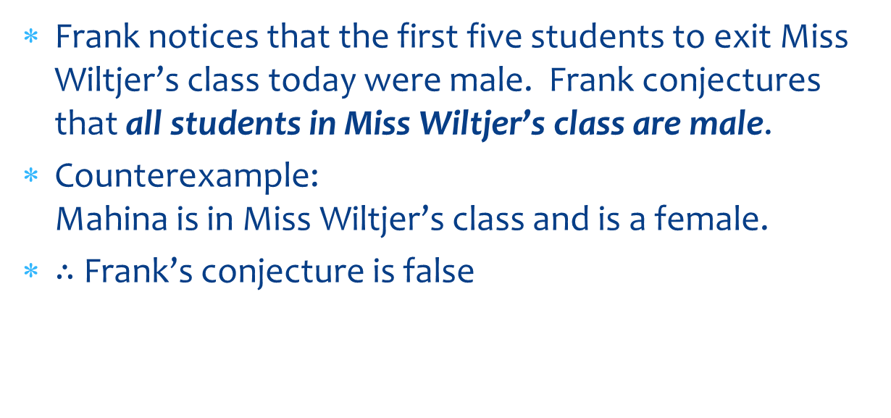
Counterexamples
Frank notices that the first five students to exit Miss Wiltjer’s class today were male. Frank conjectures that all students in Miss Wiltjer’s class are male.
Counterexample: Mahina is in Miss Wiltjer’s class and is a female.
$∴$ Frank’s conjecture is false

Slide 10
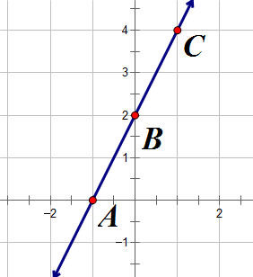
Counterexamples & Conjectures
Write a conjecture based on the given information. If appropriate, draw a figure to illustrate your conjecture.
Given: A(-1, 0), B(0, 2), C(1, 4)
Conjecture: Points A, B, and C are collinear.

Slide 11
Counterexamples & Conjectures
Determine if the conjecture is true or false based on the given information. If true, explain your answer. If false, state a counterexample.
Given: $∡1$ and $∡2$ are supplementary angles. $∡1$ and $∡3$ are supplementary angles.
Conjecture: $∡2≅∡3$
True.
If $∡1$ and $∡2$ are supplementary, the sum of their angles is 180.
Then, $m∡2=180−m∡1$.
By the same logic, $m∡3=180−m∡1$.
Therefore, since both $m∡3$ and $m∡2$ are equal, $∡2≅∡3$.

Slide 12
Counterexamples & Conjectures
Determine if the conjecture is true or false based on the given information. If true, explain your answer. If false, state a counterexample.
Given: $\overline{FG}≅\overline{GH}$
Conjecture: $G$ is the midpoint of $\overline{FH}$
False.
H
F
G

Slide 13
Homework
p. 73 #15-20, 23-26

